Slide 1
Getting started in a world of Robotics
Raunak Hede
©raunakhede.com

Slide 2
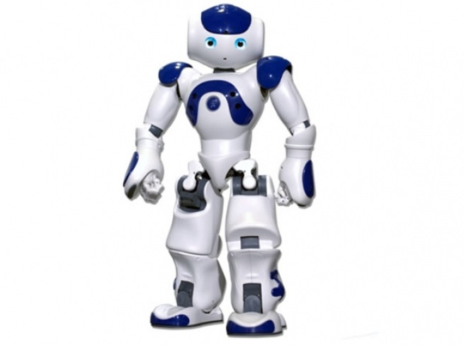
©raunakhede.com

Slide 3
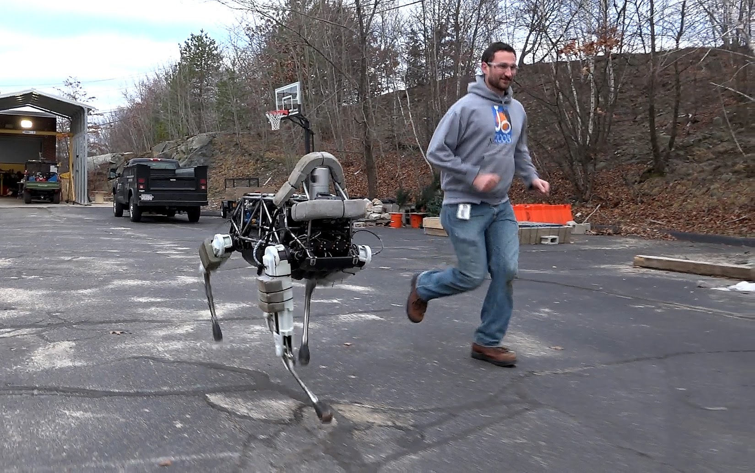
©raunakhede.com

Slide 4
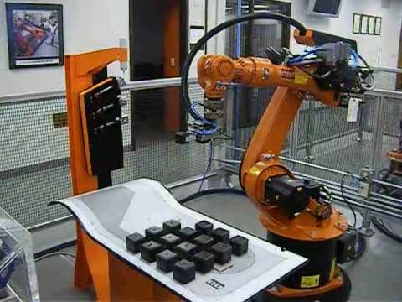
©raunakhede.com

Slide 5
Hobby robotics
A simple robot
that can do awesome stuff
©raunakhede.com

Slide 6
Hardware
Chassis
Power supply
Microcontroller
Sensors
Motors/Actuators
Development boards
©raunakhede.com

Slide 7
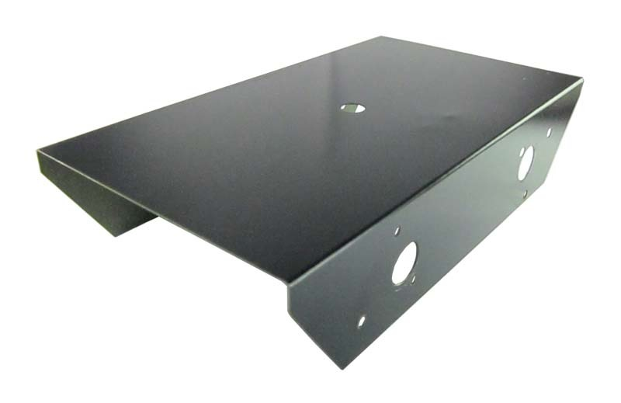
CHASSIS
©raunakhede.com

Slide 8
A more complex chassis
©raunakhede.com

Slide 9
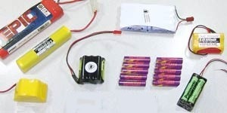
POWER SUPPLY
Lithium Polymer (Li-Po)
Lithium Ion (Li-ion)
Nickel Metal Hydride (NiMH)
©raunakhede.com

Slide 10
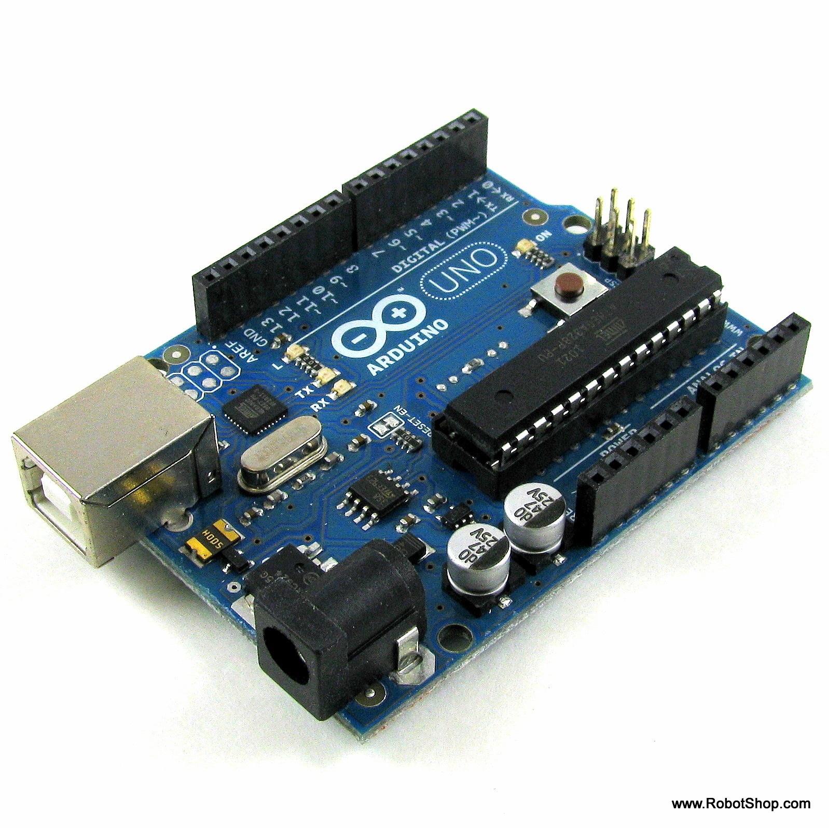
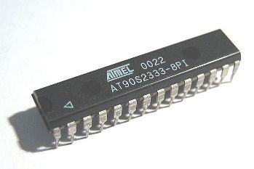
MICROCONTROLLER
Development board
©raunakhede.com

Slide 11
SENSORS
©raunakhede.com

Slide 12
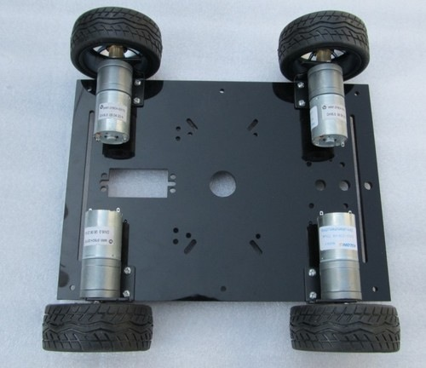
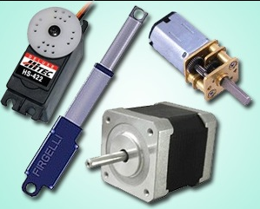
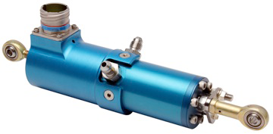
MOTORS & ACTUATORS
©raunakhede.com

Slide 13
A fully assembled robot
©raunakhede.com

Slide 14
Programming
Microcontroller
Embedded C
C++
Python
Computer
Programmer
Development
Board
©raunakhede.com

Slide 15
BASIC LOGIC
START
If there is a wall,
then stop.
If there is no wall,
then continue.
STOP
©raunakhede.com

Slide 16
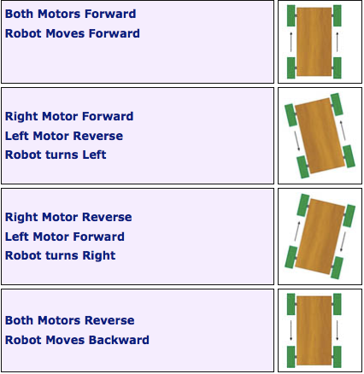
Motor movement
©raunakhede.com

Slide 17
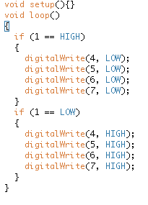
LOGIC
CODE
If (wall in front? =yes)
Left motor OFF
Right motor OFF
If (wall in front? =no)
Left motor FORWARD
Right motor FORWARD
©raunakhede.com

Slide 18
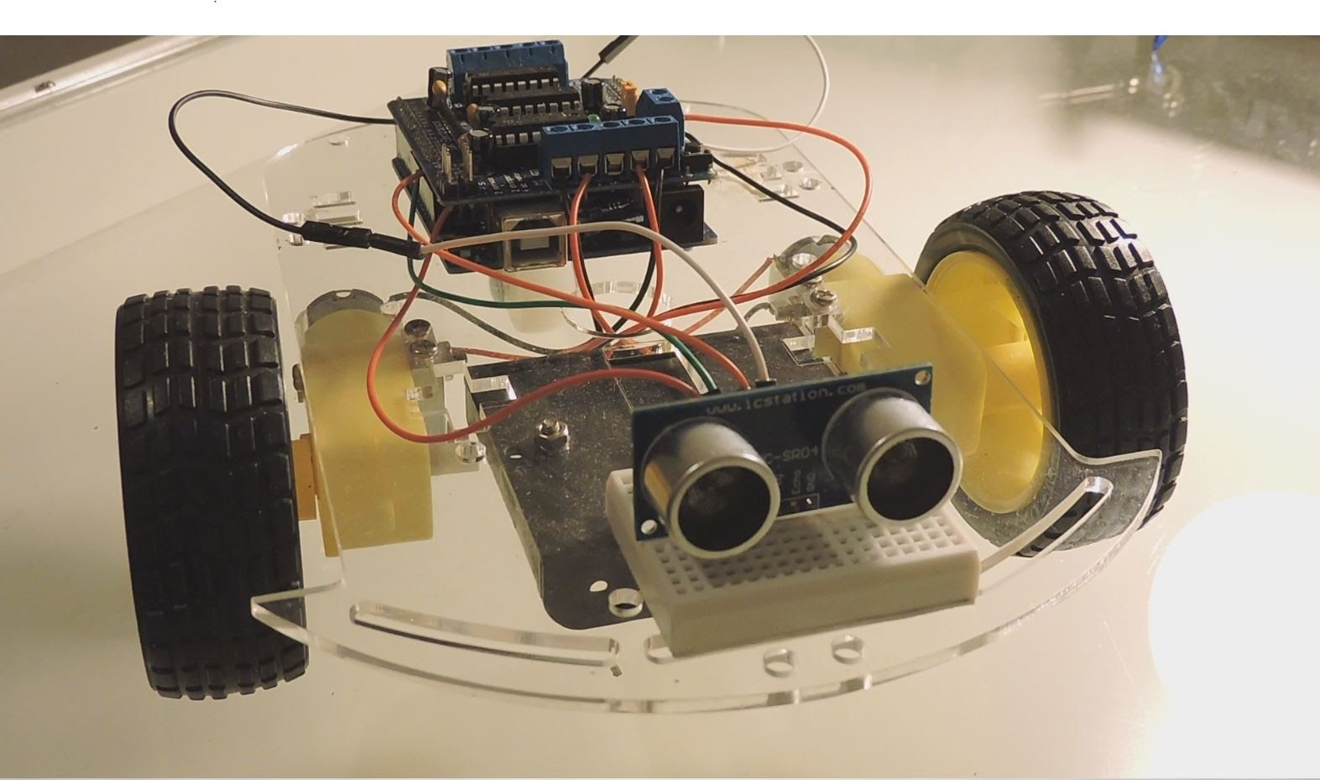
Obstacle Detection Robot
Microcontroller
Battery
Motor
Sensor
Chassis
©raunakhede.com

Slide 19
Places to source parts:
In Panjim - Electronics Centre (near KTC Bus Stand)
Online:
robokits.co.in
ventor.co.in
fabtolab.com
Websites for more information:
instructables.com
arduino.cc
electronics.stackexchange.com
raunakhede.com
©raunakhede.com

