Slide 1
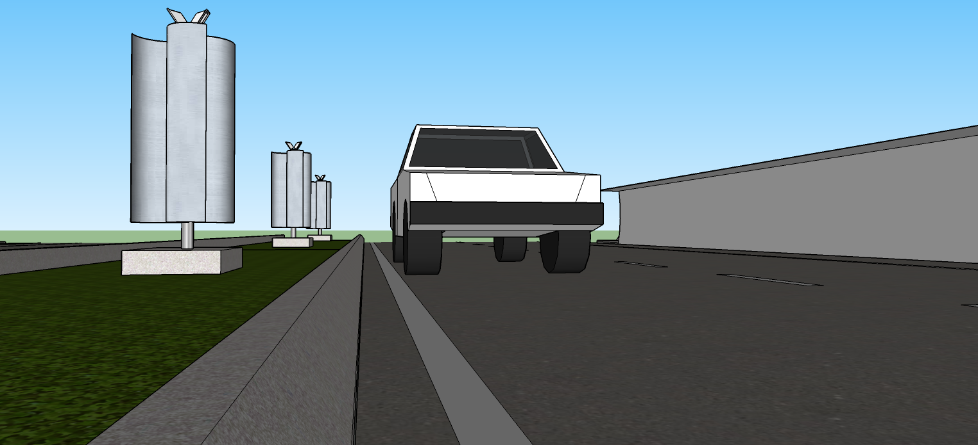
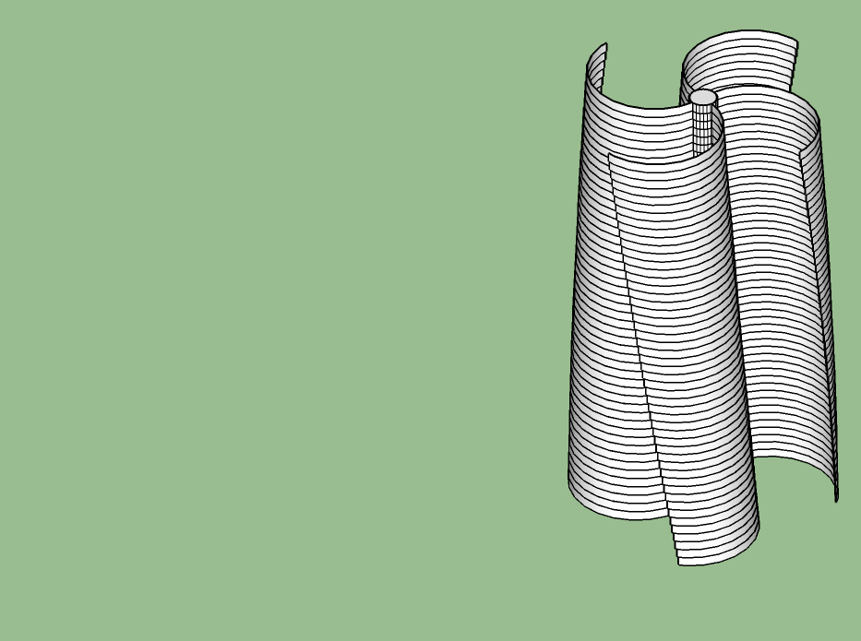
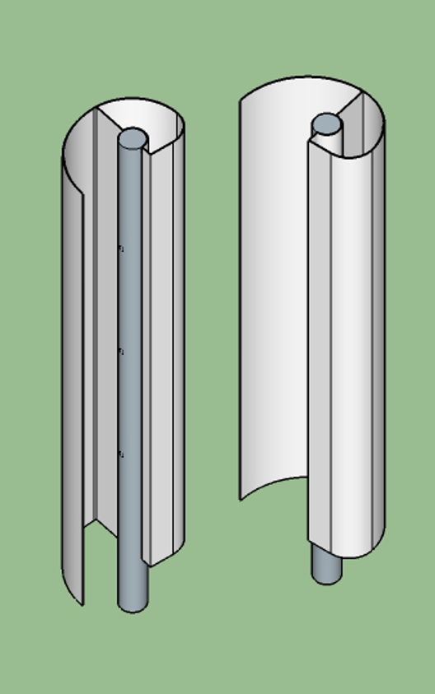
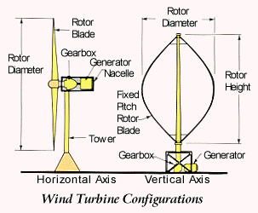
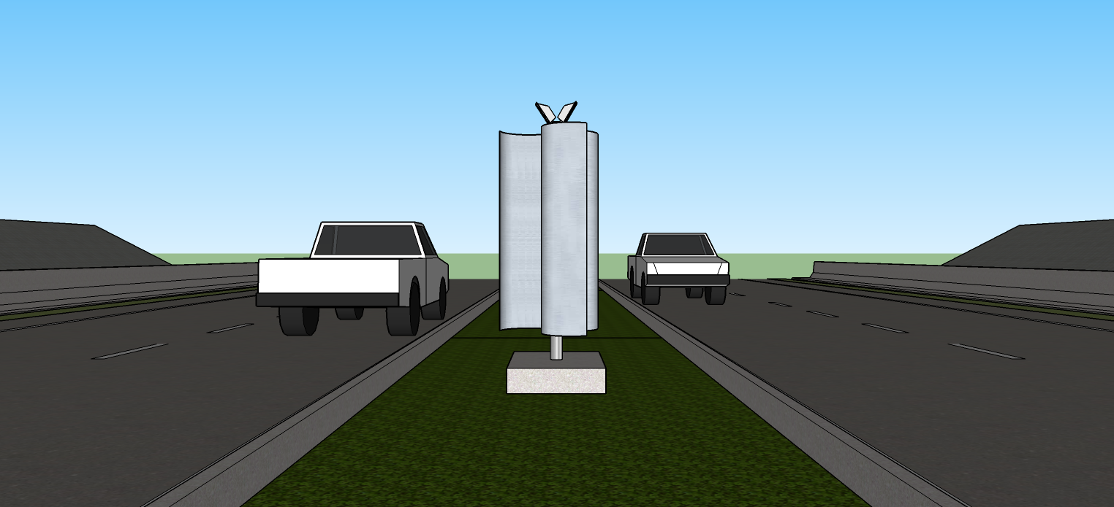
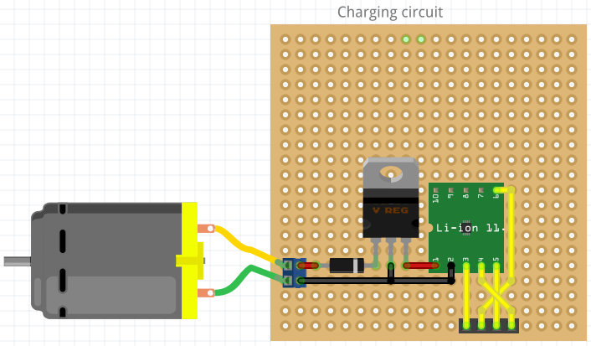
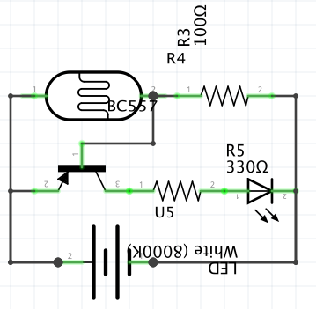
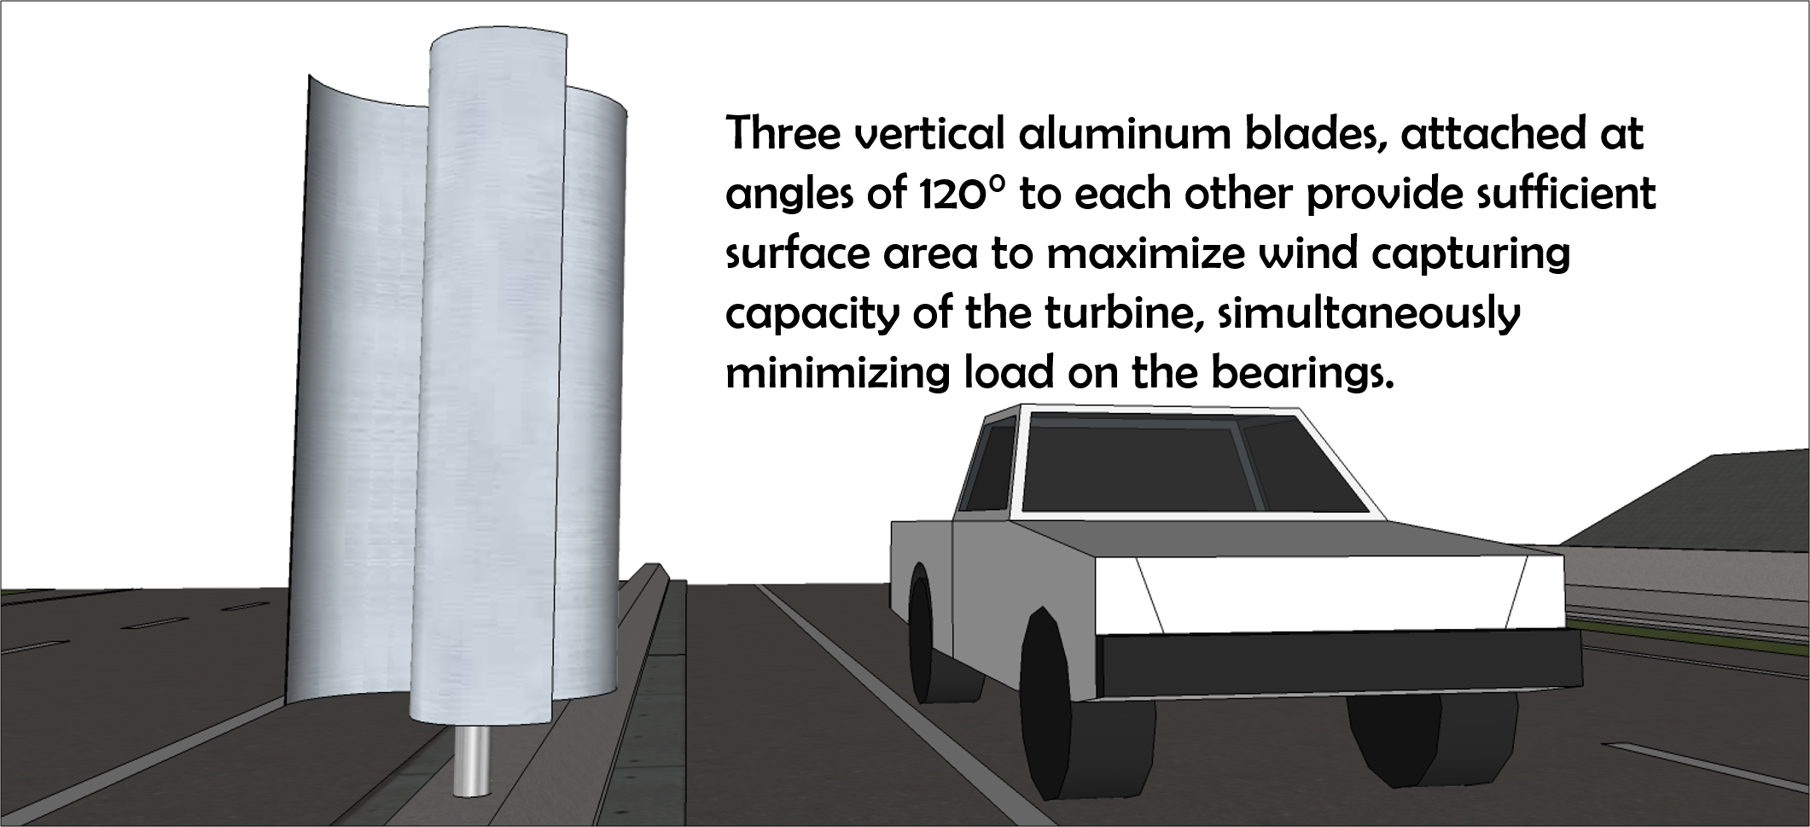
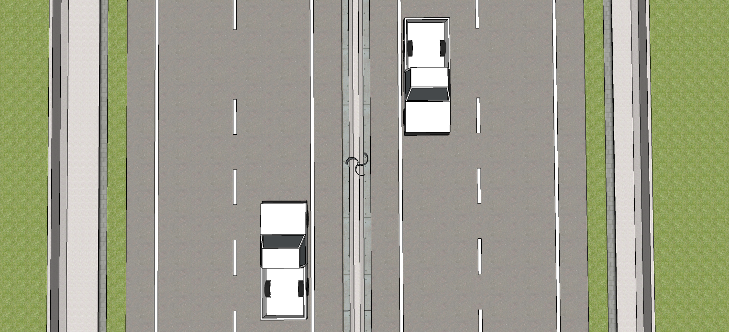
AUTOMATED HIGHWAY LIGHTING SYSTEM POWERED BY VERTICAL AXIS WIND TURBINE
The demand for electricity has greatly increased. Many efforts have been made to use renewable energy as an efficient, eco-friendly, cheaper substitute to conventional fossil fuels. Wind is one of those forms of energy which, despite its great potential, remains insubstantially untapped. Motion of vehicular traffic on highways consequently produces wind which we have tried to efficiently utilise to produce electricity with a vertical axis wind turbine. The energy generated is stored in a battery and used to automatically light an LED streetlamp at night.
DESIGN PROCESS
Three vertical Aluminium blades, attached at an angle of 120° to each other provide sufficient surface area to maximize wind capturing capacity of the turbine, simultaneously minimizing the load on the bearings.
Version 1
Fibonacci spiral pattern comprising a single fin
Version 2
Four main blades with fin sections arranged at a minute angle to each other
Version 3
Three main blades arranged in a triple helix
Final Design
Three main blades in vertical orientation
National Highway Authority of India specifications state that the minimum required median width is 2 metres. Since the turbine will be placed on medians of highways, the blades are designed to stay within 50-cm of the edge of the model.
Electrical Energy Generated
Battery Charged
Autonomous Lighting System

Slide 2
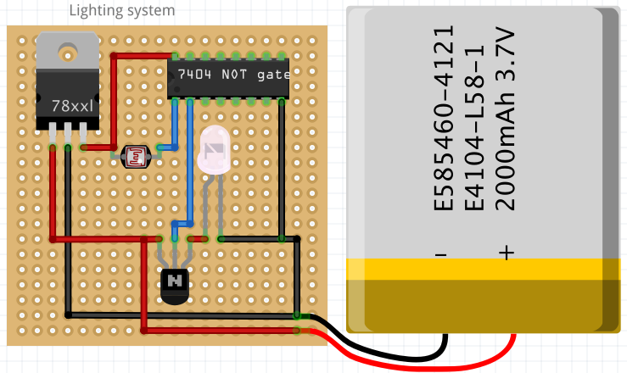
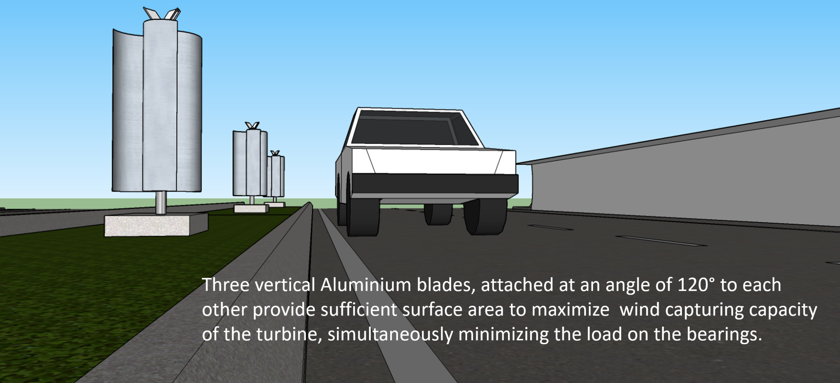
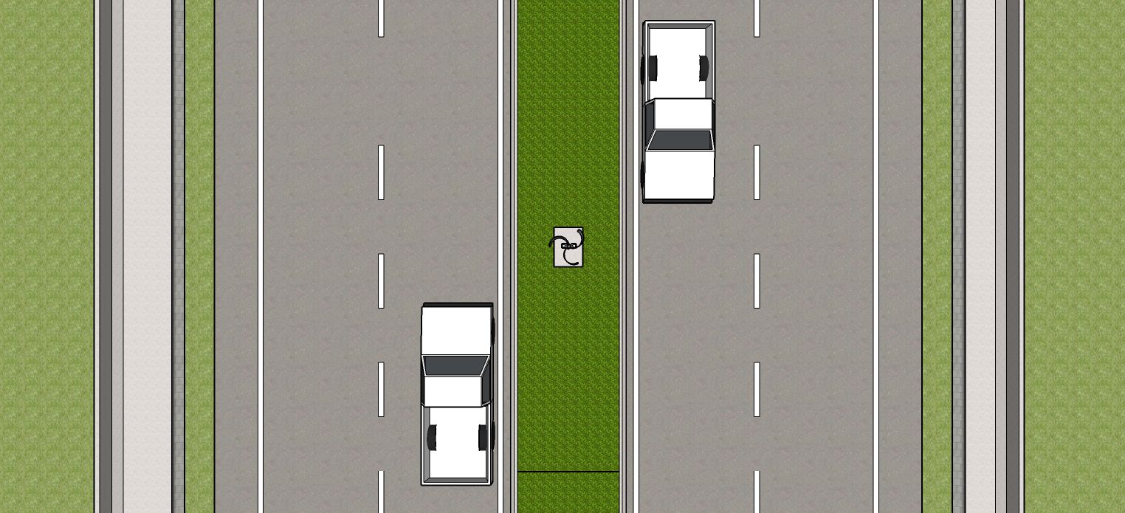
AUTOMATED HIGHWAY LIGHTING SYSTEM POWERED BY VERTICAL AXIS WIND TURBINE
The demand for electricity has greatly increased. Many efforts have been made to use renewable energy as an efficient, eco-friendly, cheaper substitute to conventional fossil fuels. Wind is one of those forms of energy which, despite its great potential, remains insubstantially untapped. Motion of vehicular traffic on highways consequently produces wind which we have tried to efficiently utilise to produce electricity with a vertical axis wind turbine. The energy generated is stored in a battery and used to automatically light an LED streetlamp at night.
DESIGN PROCESS
Version 1
Fibonacci spiral pattern comprising a single fin
Version 2
Four main blades with fin sections arranged at a minute angle to each other
Version 3
Three main blades arranged in a triple helix
Final Design
Three main blades in vertical orientation
Electrical Energy Generated
Battery Charged
Autonomous Lighting System

