Slide 1
Automated Highway Lighting System Powered by Vertical Axis Wind Turbine
- by Raunak Hede & Siddhant Govekar
Sharada Mandir School
(Miramar, Panaji, Goa)
Notes:
NOTE:
To change the image on this slide, select the picture and delete it. Then click the Pictures icon in the placeholder to insert your own image.

Slide 2
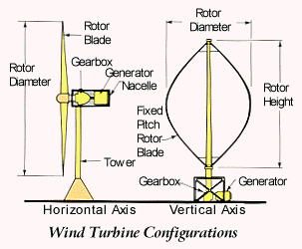

Slide 3
DESIGN

Slide 4
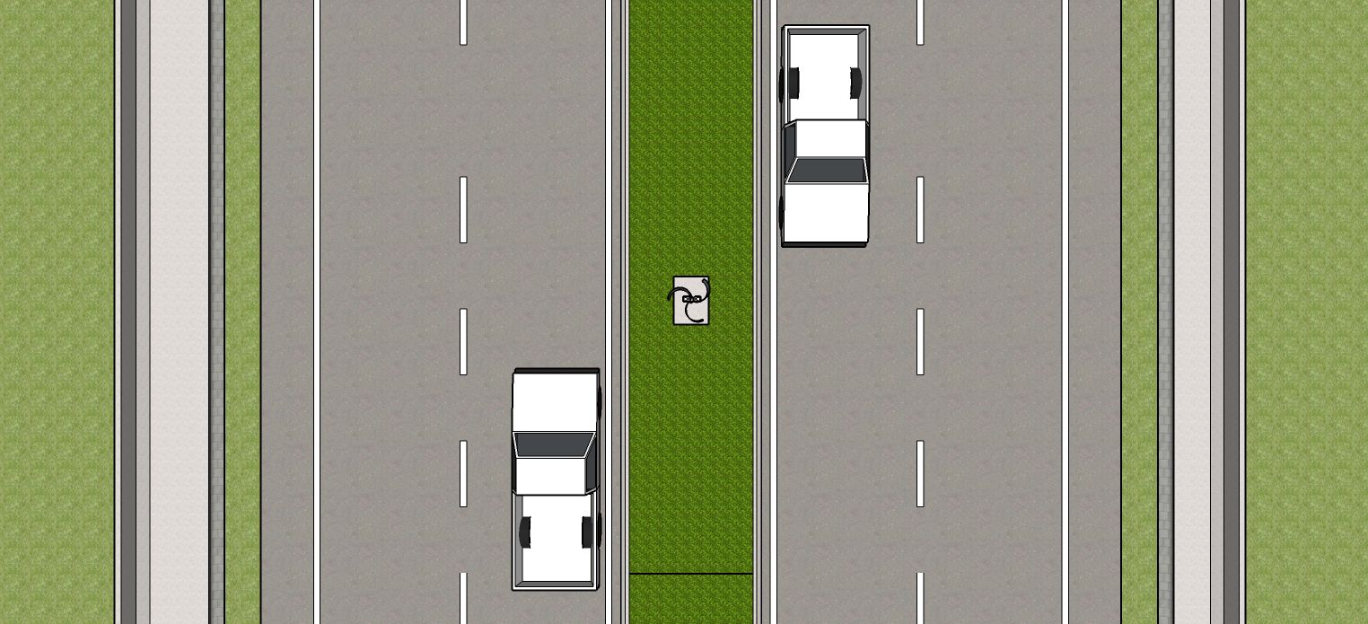

Slide 6
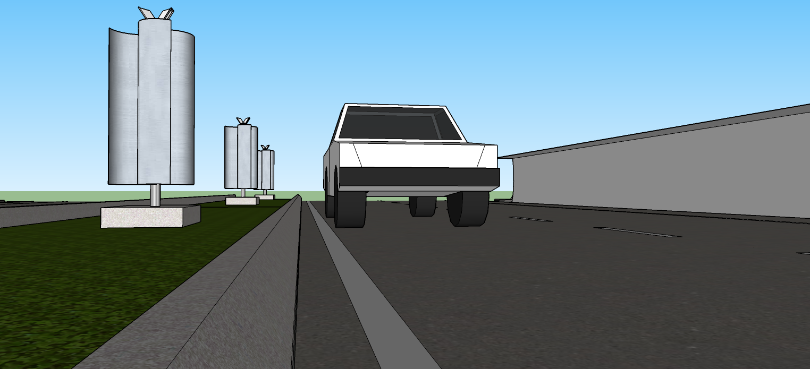

Slide 7
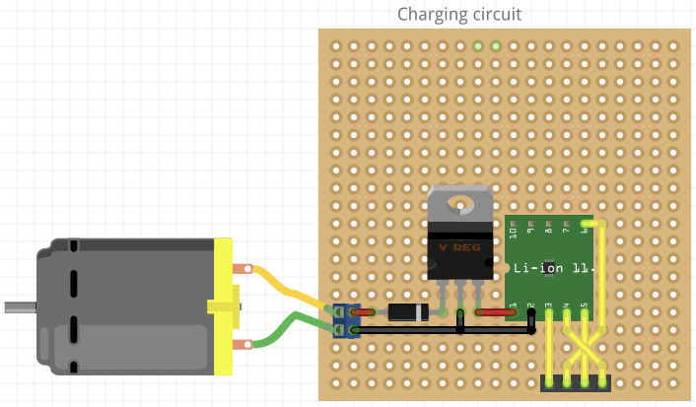
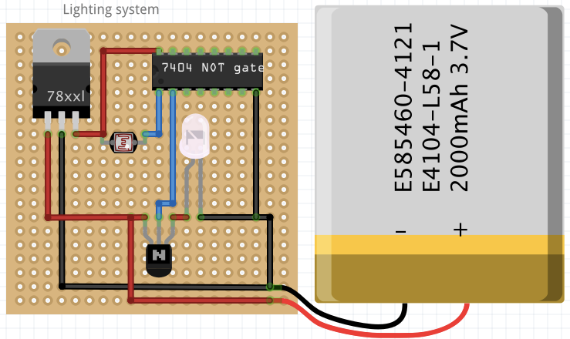
FUNCTIONING OF THE CIRCUIT
WIND
GENERATOR
VOLTAGE
REGULATOR
CHARGING
CIRCUIT
BATTERY
VOLTAGE REGULATOR
STREET LIGHT
CURRENT-LIMITING
RESISTOR
INVERTER
TRANSISTOR
AMBIENT LIGHT SENSOR

Slide 8
ADVANTAGES
Immune to varying wind direction
Cheap installation & easy maintenance
Forms a visual barrier
Not adversely affected by changing weather
Efficiently utilises 60% more energy

Slide 9
FUTURE SCOPE

